Slide 1

Project Title:
Society Management System
Guide: Prof. Chirag Gami
Team Members:
Rudra Patel (22012011138)
Yash Patel (22012011139)
Harsh Shah (22012011145)
Riya Maurya (22012011154)

Slide 2
Vision and Mission of Ganpat University
Vision | It shall be the constant endeavour of Ganpat University to meet the educational needs of the youth in the areas of professional studies and provide state-of the art learning opportunities along with inculcation of values of commitment and uprightness.
Mission | Seek, search and offer programs that lead to symbiotic emergence of 'academic excellence' and 'industrial relevance' in education and research.

Slide 3
Vision and Mission of Computer Engineering
Vision | Department aims to achieve its recognition as a leading contributor in the area of technical education of computer engineering by practicing latest principles, tools and technologies to cope with current and future challenges and hence contributing to global welfare.
Mission | To educate and inculcate strong fundamentals of science and computer engineering through best teaching learning practices. To impart high quality education to acquire skills to conduct research and solve complex problems through modern tools, technologies and innovative practices. Enabling youth for employability, social upliftment, following good moral practices and professional ethics. Preparing youth for contributing in advancements of technology and society. Encouraging students to be adaptive, courageous and life-long learners.

Slide 4
After successful completion of this course, student will be able to:
Write the problem/task specification in existing system.
Select, collect and use the required information/knowledge to solve the problem.
Logically choose relevant possible solution(s).
Assess the impact of project on society.
Prepare project proposal with action plan and time duration scientifically before beginning the project.
Communicate effectively and confidently as a member and leader of team

Slide 5
Abstract:
Society Management System follows “Simplicity is the ultimate sophistication” phrase and aims at making the current situation in the society simple and efficient.
This System reduces the conflicts that arise within the society by providing facilities such as Alert , Vendors & Services, Directory, Helpdesk, Visitor Management , Delivery/Courier Management , Staff / Helper Management , Reports etc.
It automates bulletin that occur within the society and makes it easy for the members of the society an easy access to the society happenings and on goings .
The main aim of the project is to provide utility to maintain day to day operations of the society .This system helps them to store all transactions electronically in a system, which in turn saves lot time, money and energy.

Slide 6
Introduction:
In today's dynamic environment, managing societies—whether they are residential communities, professional organizations, or other types of groups—requires a sophisticated approach to ensure efficiency and transparency. Traditional methods of management, often reliant on manual processes and disparate tools, can lead to inefficiencies and challenges in communication and coordination.
To address these issues, this document proposes the development of a comprehensive Society Management System (SMS) software.

Slide 7
Problem Definition:
Managing residential societies involves numerous administrative, financial, and operational challenges, often leading to inefficiencies, miscommunication, and dissatisfaction among residents. Current management practices are largely manual, disorganized, and lack the technological infrastructure needed for streamlined operations. This results in time-consuming tasks such as maintenance tracking, utility billing, resident communication, and record-keeping, often prone to errors and delays.

Slide 8
Proposed Solution:
A Society Management System that integrates digital tools and automation can address these issues by providing a centralized platform for managing all aspects of society operations, improving communication, and enhancing resident satisfaction.
The Society Management System will serve as an integrated platform designed to simplify and automate routine operations, offering a central hub for all management activities. By leveraging modern technology, the system will provide features such as automated billing, real-time communication channels, event management, and detailed reporting capabilities.

Slide 9
Hardware Requirements:
Development Machines:
RAM : Minimum 8GB
Storage: 256GB SSD
Processor : Intel i3 or equivalent.
Devices: Android and iOS smartphones and Laptop .

Slide 10
Software Requirements:
Operating System: Windows 8, macOS
Development Environment: Visual Studio Code
Database: MySQL
Version Control: Git
Deployment: AWS

Slide 11
Functional Requirements:
1. Alert
Whether it is a community meeting or some social events, or even an emergency drill, software provides
one click alert option to Society Members as well as Tenants to get information, connect and participate.
2. Vendors & Services
Now Buy, Sell or Rent out items within the premises with ease. Find local vendors for pest control, laundry
or event organizer and much more.
3. Directory
Get instant information about society members or committee members. Our Emergency Tab allows you
to contact the nearby police station, fire brigade or hospital facility quickly.
4. Helpdesk
In case of a complaint, society members can easily raise the issue through mobile app.

Slide 12
5. Visitor Management
With visitor management system, residents get notified on arrival of visitors.
6. Delivery Management
This ensures smooth and secure deliveries. The app comes with a simple Delivery management workflow.
7. Staff Management
This app creates unique identity number for each domestic staff (Housekeeping, Driver, Cook etc.).
Residents get alert on mobile on arrival or exit of staff.
.

Slide 13
Non Functional Requirements:
1. Performance
The system should handle at least 500 concurrent users without performance degradation.
2. Scalability
The software should be able to scale to accommodate growing numbers of users (residents, visitors,
admin staff) and increased data over time.
3. Security
The system must implement role-based access control to ensure that only authorized users can
access sensitive data.

Slide 14
4. Maintainability The system should be modular, allowing for easy updates and bug fixes without significant downtime. 5. Usability The user interface should be intuitive and easy to navigate, ensuring that residents of all ages can use the system without difficulty.

Slide 15
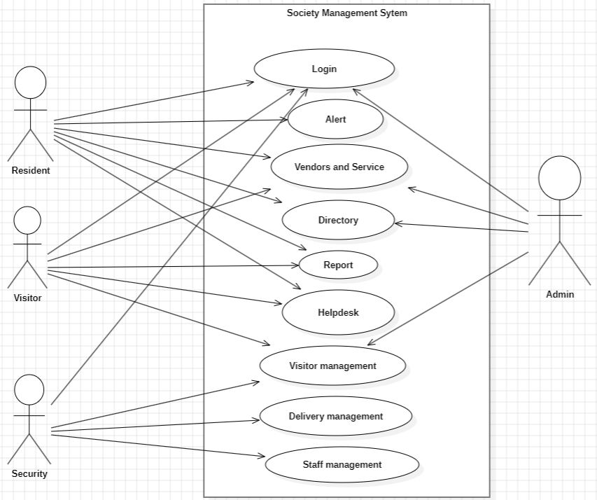
Use Case Diagram:
The Use Case Diagram for the society management system illustrates the interactions between different types of users and the system's features. It includes actors such as Residents, Society Administrators, and Security Staff. Residents perform actions like logging in, accessing alerts, interacting with vendors and services, viewing the directory, submitting reports, and using the helpdesk. Society Administrators oversee functionalities such as vendor and service management and visitor management. Security Staff focus on managing visitors, deliveries, and staff. The diagram highlights how these actions relate to the system's core functionalities, ensuring seamless integration and role-specific access to various features

Slide 16
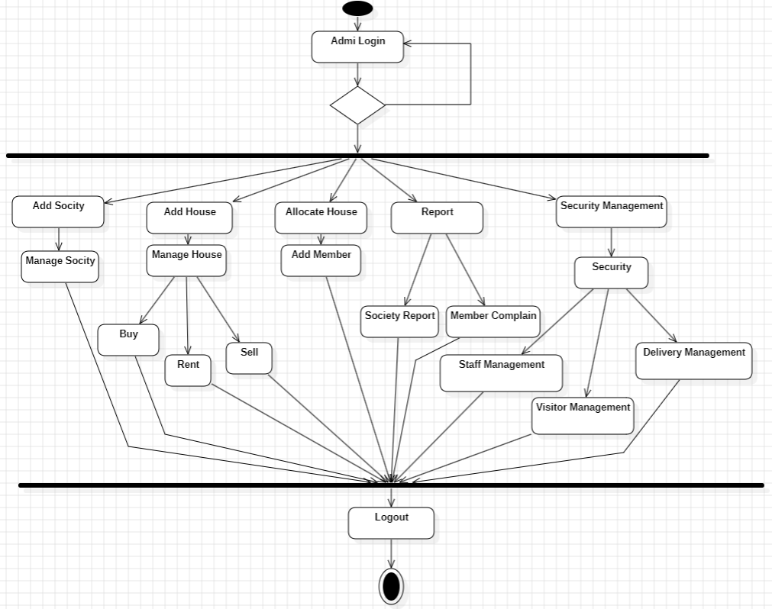
Activity Diagram:
The Activity Diagram illustrates the workflow for managing society administration in the system. It begins with the Admin logging in, followed by authentication to verify access. Once authenticated, the process moves through key activities such as adding new societies and houses, allocating houses to residents, and overseeing security management. Decision points, such as successful login and available houses, guide the flow of actions. The diagram also highlights how Security Staff manage visitor and delivery tracking, ensuring compliance with safety protocols. This visualization clarifies the step-by-step process and the interconnection of actions, ensuring efficient management of society operations.

Slide 17
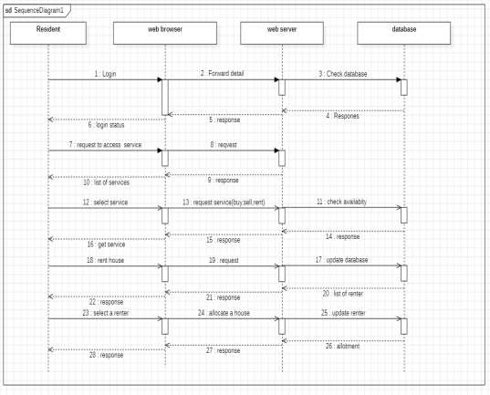
Sequence Diagram:
The Sequence Diagram shows the interactions between a Resident, web browser, web server, and database in the society management system. It starts with the Resident logging in, followed by authentication through the web server and database. Once authenticated, the Resident requests services, selects one (e.g., buying, selling, or renting), and the server checks availability in the database. The system updates the database and confirms the transaction, providing a clear view of the step-by-step process and message flow.

Slide 18
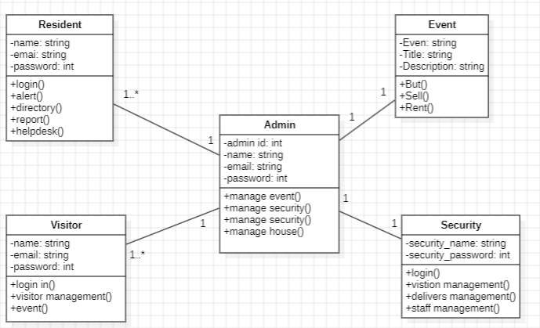
Class Diagram:
The Class Diagram provides a structured view of the society management system's data model .The diagram illustrates relationships such as associations (e.g., an Admin interacts with Security and Event classes) and dependencies (e.g., Resident activities depend on Event and Visitor management). This helps in understanding the system's static structure and how its components interact

Slide 19
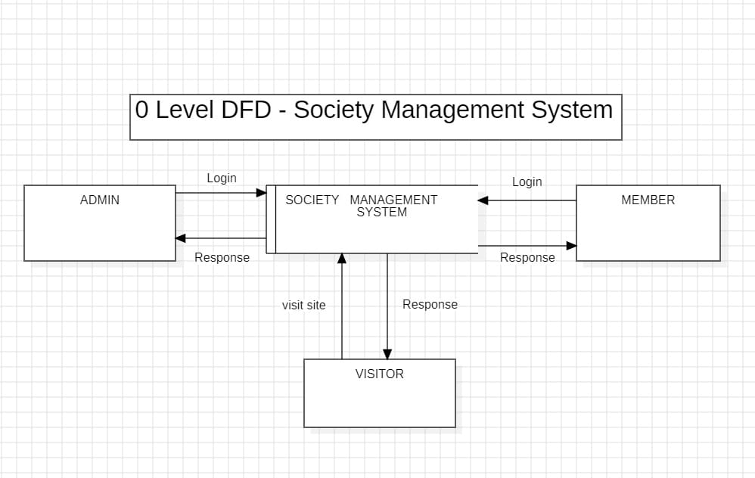
DFD Diagram:
LEVEL 0
The Level 0 DFD of the Society Management System illustrates the interactions between the system and external entities: Admin, Member, and Visitor. The system handles login requests from Admin and Member, providing responses, while the Visitor simply visits the site without logging in. This diagram provides a high-level overview of how each entity communicates with the system.

Slide 20
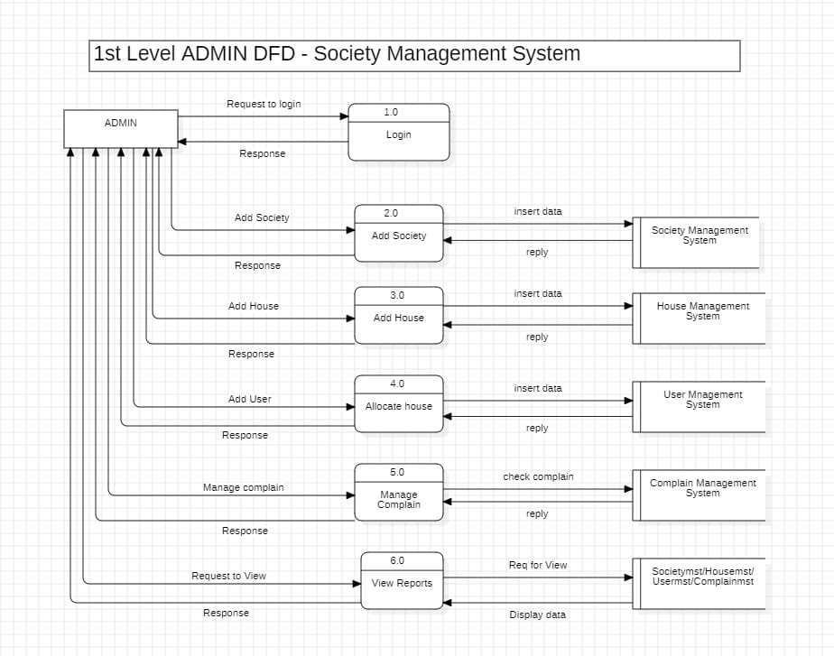
LEVEL 1
The Level 1 DFD for the Admin in the Society Management System provides a detailed breakdown of the admin's interactions with various system subprocesses. It shows how the admin logs in, adds societies, houses, and users, allocates houses, manages complaints, and views reports. Each subprocess, such as Add Society, Add House, and Manage Complain, involves inserting data and receiving responses from associated systems like the Society Management System, House Management System, and Complaint Management System. This diagram illustrates the flow of data between the admin and the system's different components, offering a more detailed view of the internal processes and their interactions.

Slide 21
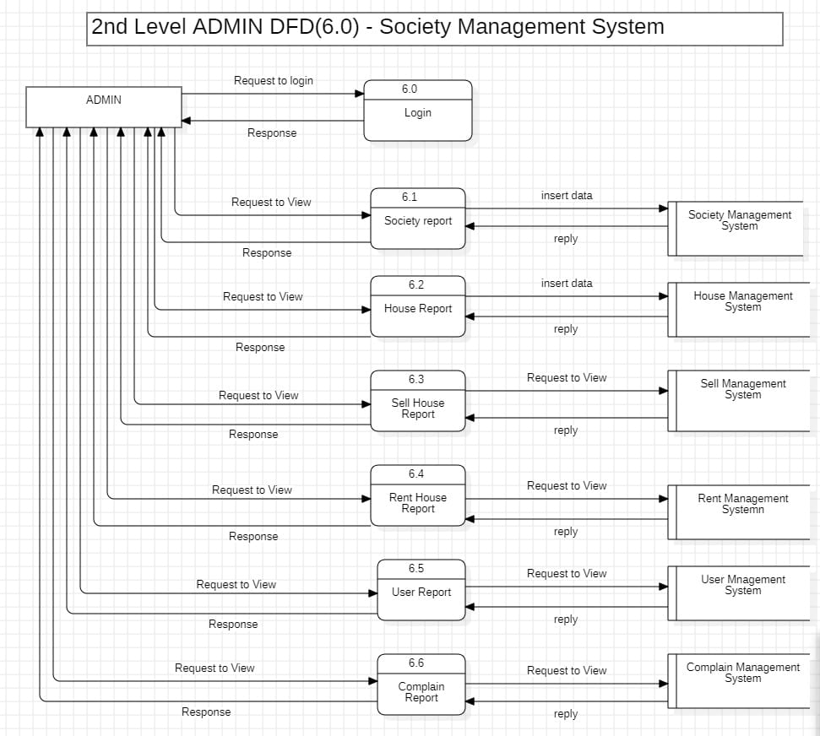
LEVEL 2:
The Level 2 Data Flow Diagram (DFD) for the Society Management System provides an in-depth view of the administrative functions, focusing on various reports and management processes. It outlines the interaction between the Admin and the system's key subsystems, such as Society Management, House Management, Sell Management, Rent Management, User Management, and Complain Management. Each subsystem handles specific operations, including generating reports, inserting data, and replying to user queries. The diagram clearly depicts the data flow, requests, and responses between the Admin and these components, illustrating how they collectively support the system's functionality.

Slide 22
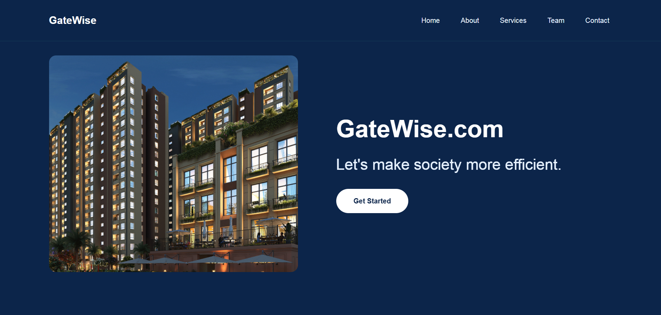
User Interface
Home Page:

Slide 23
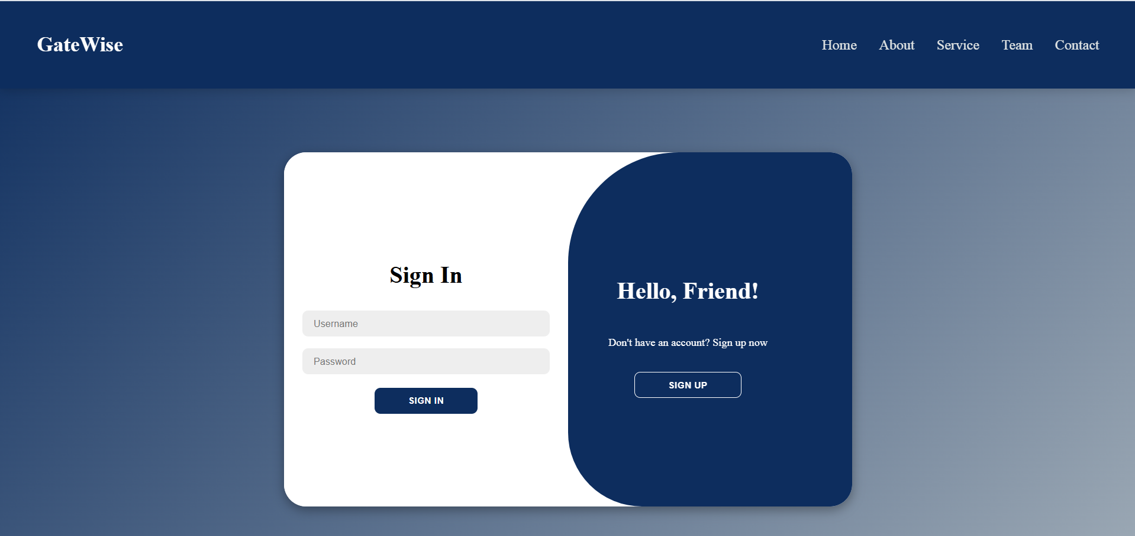
Sign In:

Slide 24
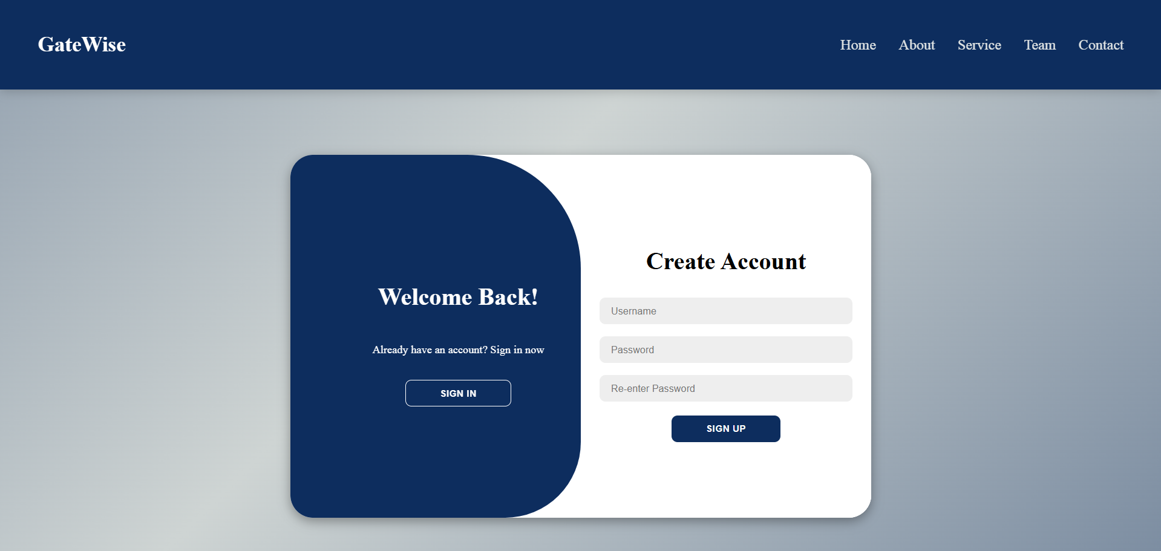
Sign-Up Page:

Slide 25
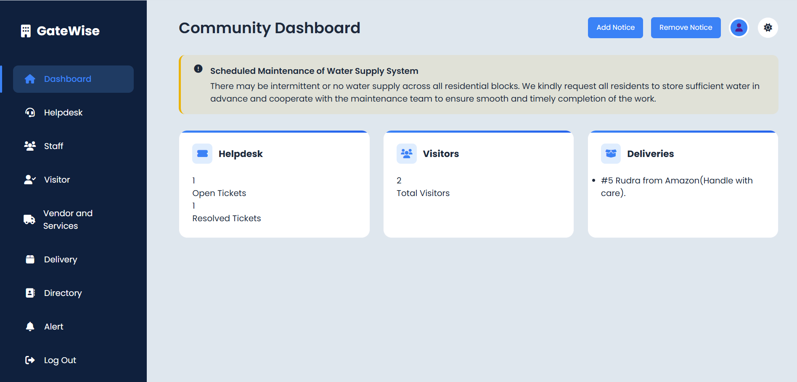
Dashboard
The dashboard of the Society Management Application Admin Panel serves as the central interface, providing administrators with a comprehensive overview of the system's critical statistics and functionalities. The Helpdesk, Manage user, Alert, Directory, Delivery Management, Staff Management, Vendor And Services, Visitor Management and ensuring efficient oversight of society operations.

Slide 26
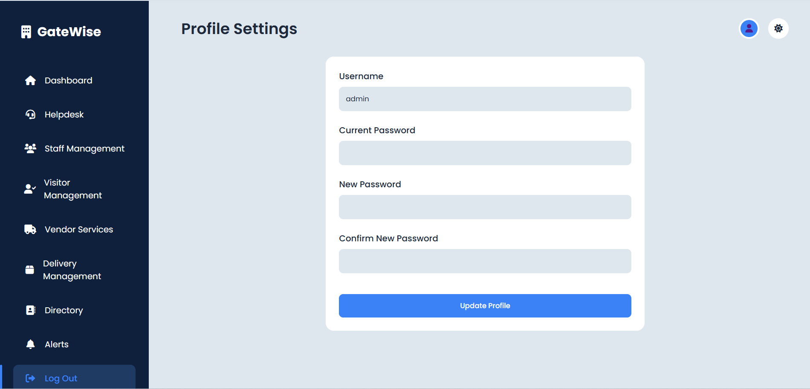
Profile
The Profile feature in a Society Management System web application enables users to manage their personal information. Residents can edit their profile photo, update their name, email, and address, ensuring accurate and up-to-date records for effective communication and system functionality.

Slide 27
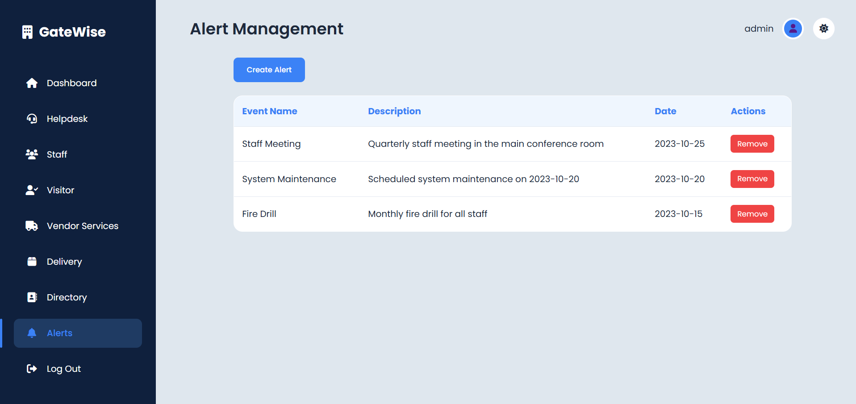
Alert
The Alert feature in a Society Management System web application allows administrators to send emergency messages or notifications about society meetings. This ensures timely communication of important updates, enhancing resident safety and keeping them informed about key events or emergencies within the society.

Slide 28
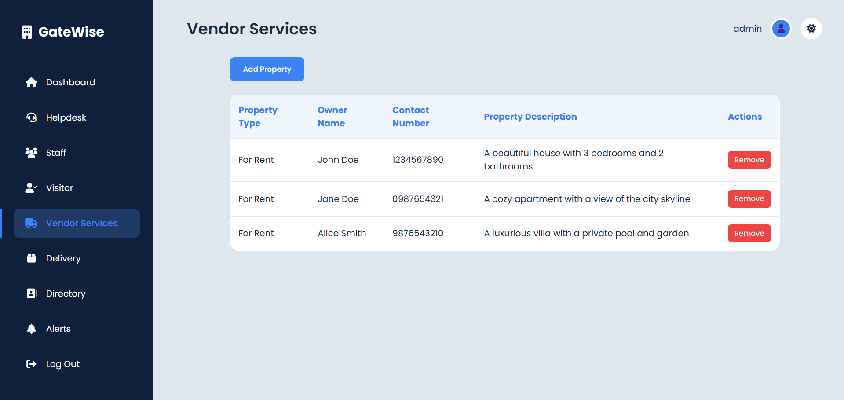
Vendors and Services
The Vendor and Services feature in a Society Management System web application allows users to add, remove, or update the status of their property, such as buying, selling, or renting. This function helps residents manage their housing needs efficiently and provides a platform for updating property status, enhancing communication between residents and vendors or service providers.

Slide 29
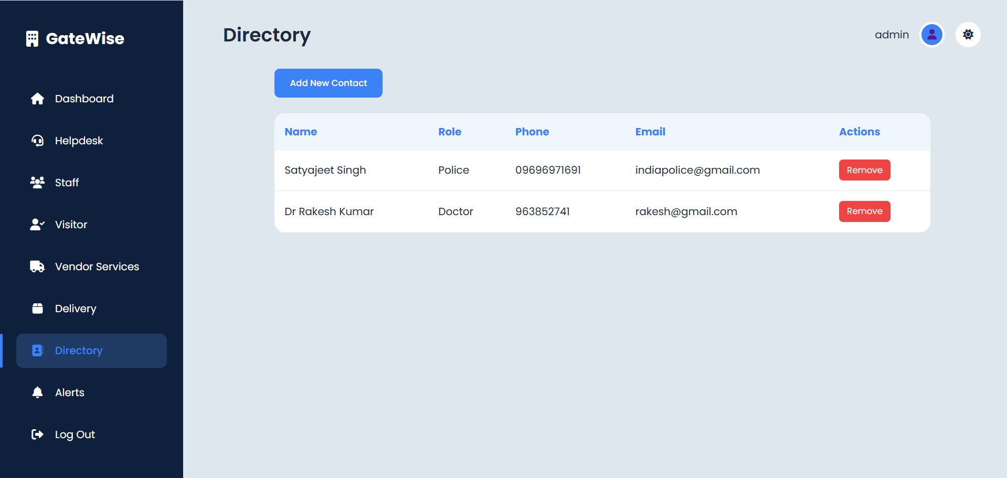
Directory
The Directory feature in a Society Management System web application allows residents to add or edit emergency contacts. This ensures that up-to-date and critical contact information is available for quick access in case of emergencies, improving safety and communication within the society.

Slide 30
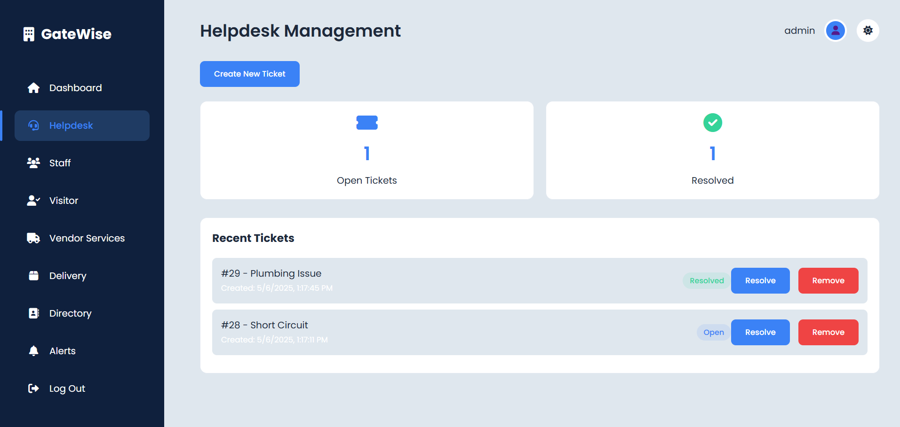
Helpdesk
The Helpdesk in a Society Management System allows residents to log complaints, such as water leakage or broken gates, for efficient resolution. It streamlines issue tracking, task assignment, and progress monitoring, ensuring prompt maintenance and better communication between residents and management.

Slide 31
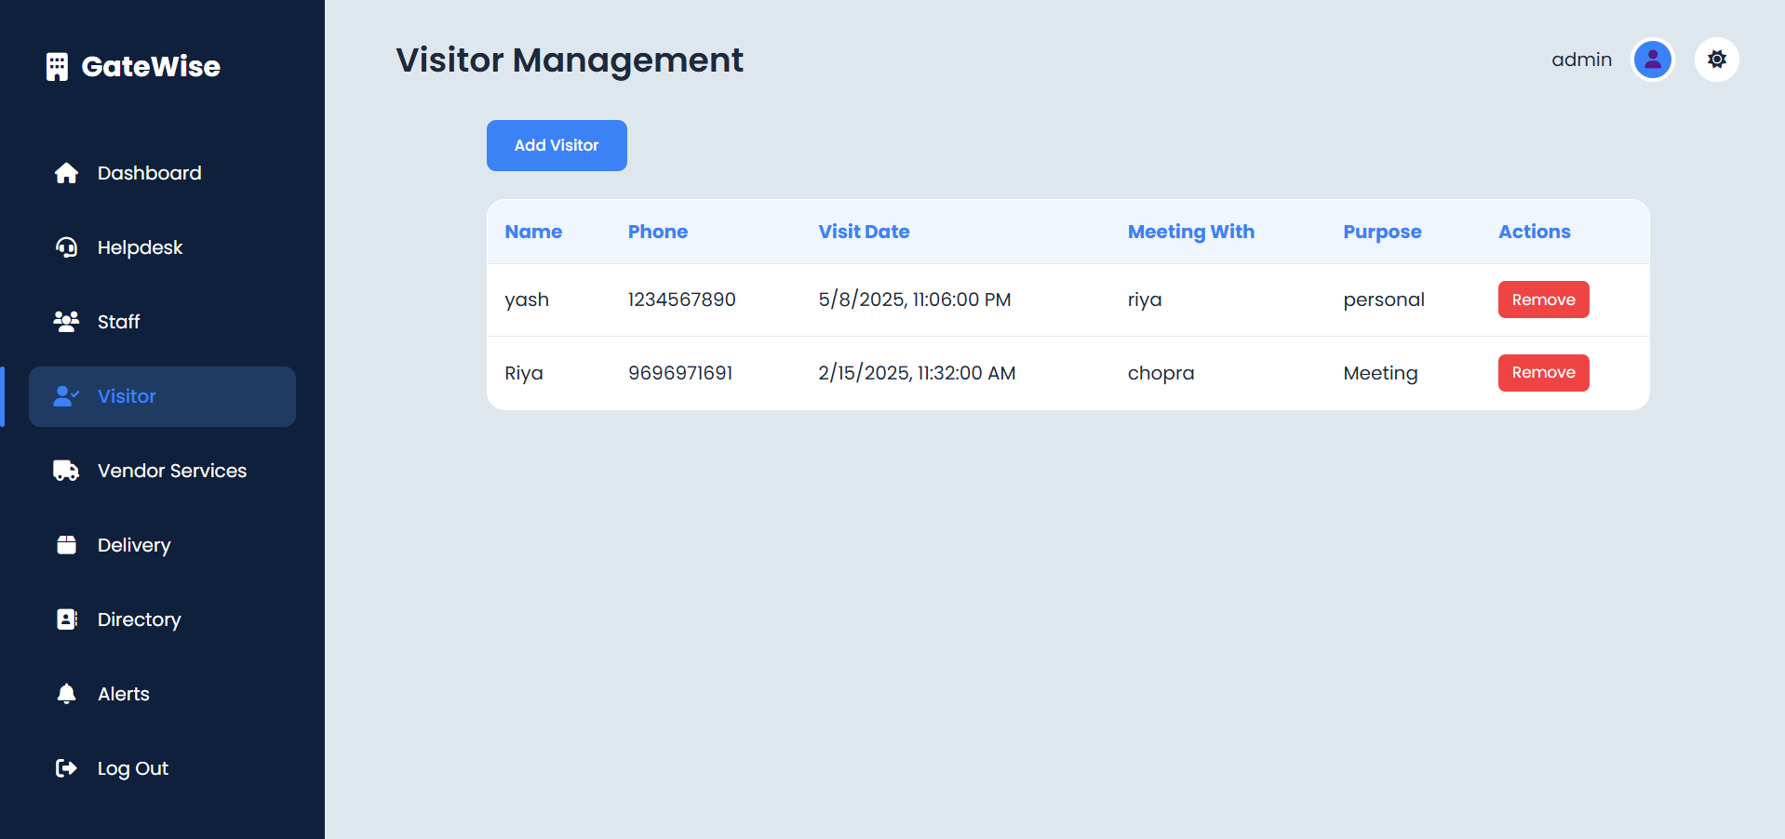
Visitor Management
The Visitor Management feature in a Society Management System web application allows administrators to add, remove, or update the status of upcoming visitors. This ensures proper tracking and coordination of visitor access, improving security and communication between residents and the management team.

Slide 32
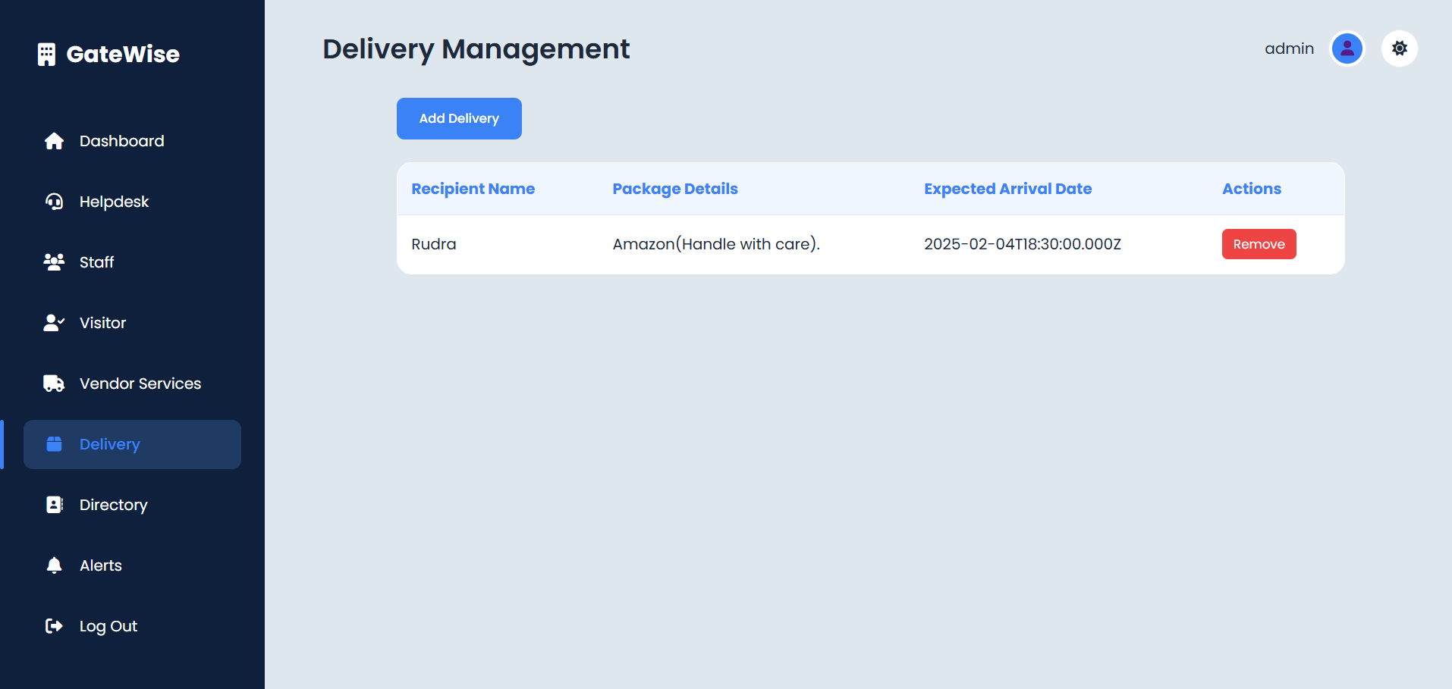
Delivery Management
The Delivery Management feature in a Society Management System web application allows administrators to add, remove, or update the status of deliveries. This ensures efficient tracking of packages and parcels, keeping residents informed about the status of their deliveries and improving overall delivery management within the society.

Slide 33
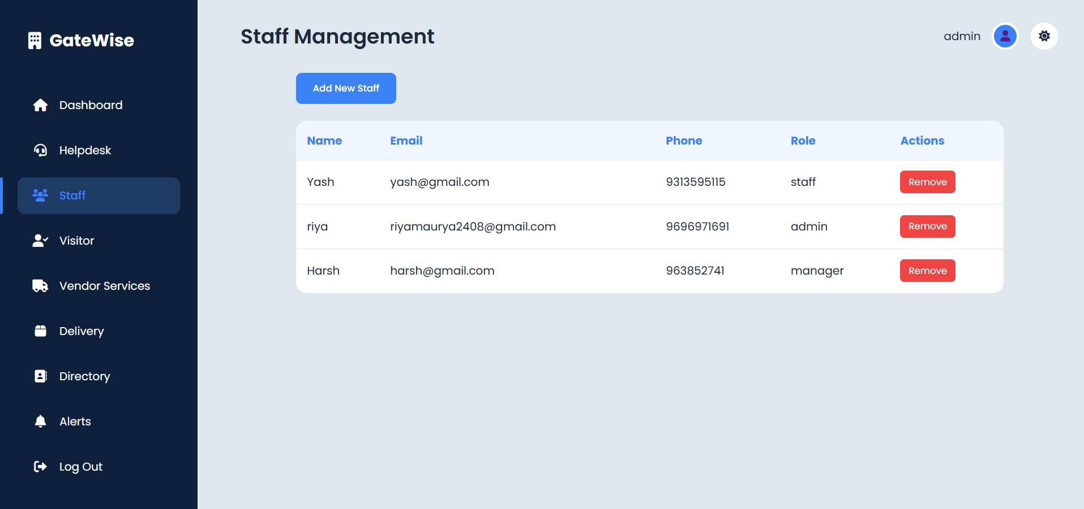
Staff Management
The Staff Management feature in a Society Management System web application allows administrators to efficiently add or remove staff members. This function helps maintain an up-to-date roster of personnel, ensuring smooth operations and effective management of tasks within the society.

Slide 34
Conclusion
The development of the Society Management System has successfully addressed several critical needs for efficient and streamlined operations within residential or community societies. The system provides a centralized platform for managing tasks such as member registration, financial transactions, maintenance requests, event management, and communication between society members and administrators. By automating many manual processes, the system has improved transparency, accountability, and responsiveness, reducing the administrative burden on society managers while enhancing the overall resident experience.

Slide 35
References:
https://mysocietyclub.com/
https://mscw.ac.in/NAAC/Criteria1/Samples-of-ProjectWork_Fieldwork/Computer_Science/software_Engineering/Software%20Engineering/society%20mgmnt/Software%20Mnagement%20Software(SMS).docx
https://chatgpt.com/
https://github.com/DarkLord125/Society-Management-System

Slide 36
Thank You

